Slide 1
EagleSat 2:
Structures and Thermal Control
Alexander Hoppe – Structures Lead
Arizona Space Grant Symposium

Slide 2
Slide Overview
Mission Overview
Structure Design
Structural Simulations
Thermal Design
Thermal Simulations
Future of Structures

Slide 3
Mission Overview
Objective: Design a CubeSat structure to integrate all subsystems while considering thermal conductivity requirements, the effects of launch vibrations, and other environmental factors
Structure: Custom CubeSat Structure
Volume: 3U
Thermal Control System: Patch Heaters

Slide 4
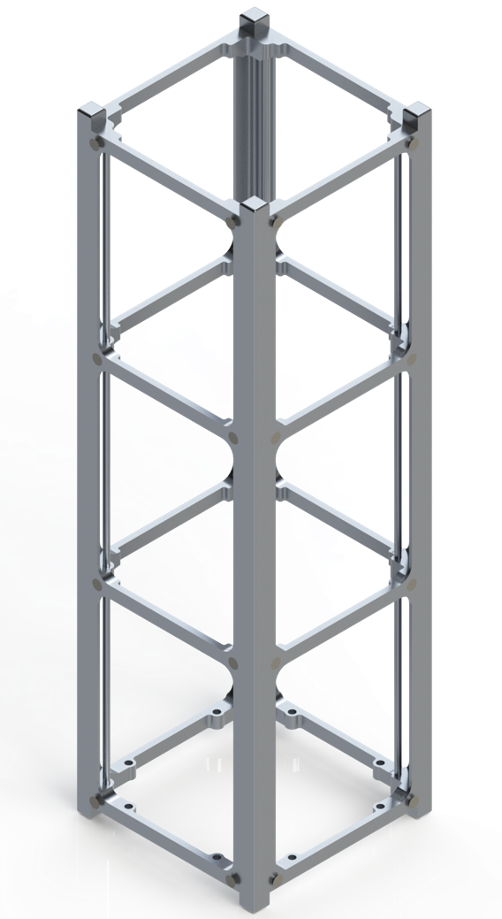
Structural Design
Designed to make efficient use of space with minimal mass
A central mounting system allows easy integration
Material 6061-T6 Aluminum
Anodized and chemically converted
Mass Estimate: 315g

Slide 5
Structural Simulation
Used ANSYS Workbench to conduct static structural simulations, solving for stress
The following simulations were performed:
Direct force on Y-axis
Launch acceleration loads
Hard/Soft stow vibration
Resulting stresses were far below the 276 MPa yield strength of Al-6061 T6

Slide 6
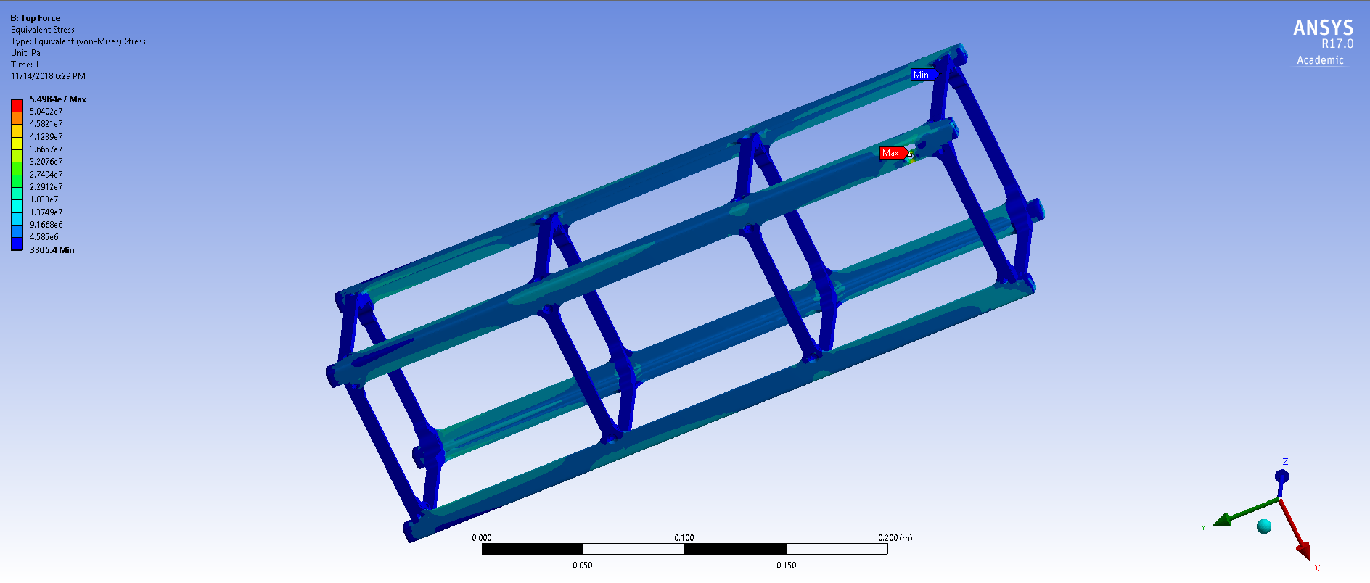
Simulation Results: +Y-axis Force
[Simulation results showcasing max stress for Y-axis force]
Max: 54.98 MPa

Slide 7
Thermal Design Overview
Detailed thermal analysis for multiple orbits has been simulated using Thermal Desktop
Based on our Thermal Simulations, low temperatures in the ADCS system were identified as our main concern
Patch heaters have been chosen for thermal control

Slide 8
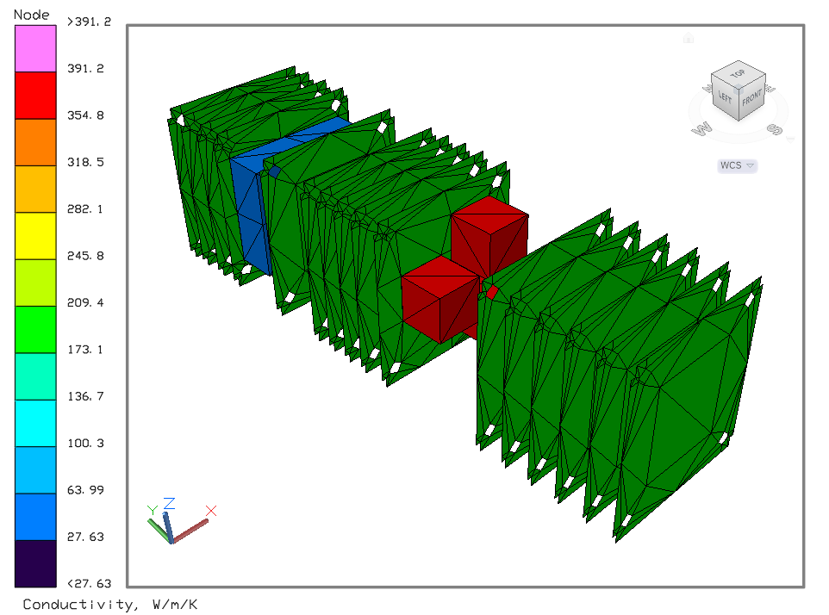
Thermal Simulation Properties
Simplified CAD model created in SpaceClaim
Material properties derived from estimations of 6-layer PCBs
Heat loads applied across boards to simplify model

Slide 9
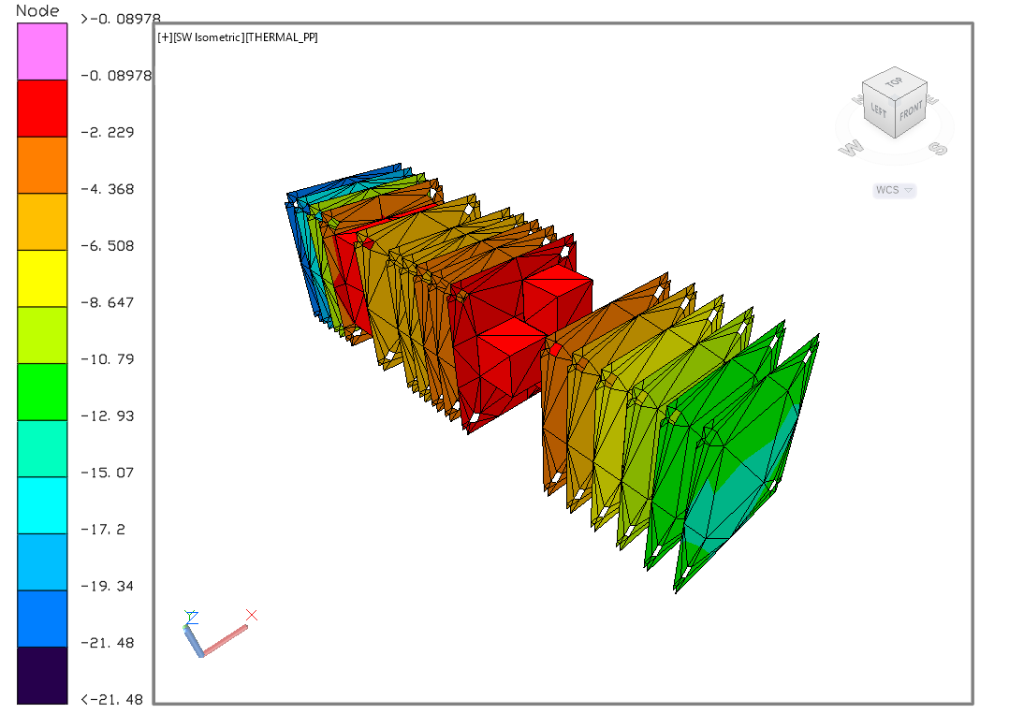
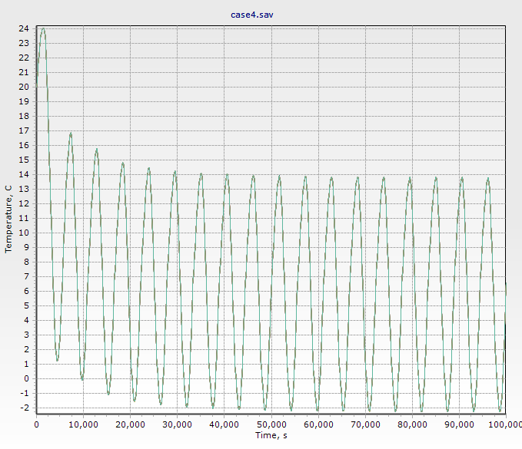
Thermal Simulation Results
Boards and Internals Near Minimum Temperatures
ACDS Reaction Wheel Temperatures

Slide 10
Fabrication Plans
All custom parts will be machined on campus
Structure parts shall be made from Al 6061-T6
To be fabricated by a computer operated 3-axis CNC machine
After machining parts will be Hard Anodized at Frontier Group
Bolts are made from 300 series stainless steel and utilize HeliCoil inserts

Slide 11
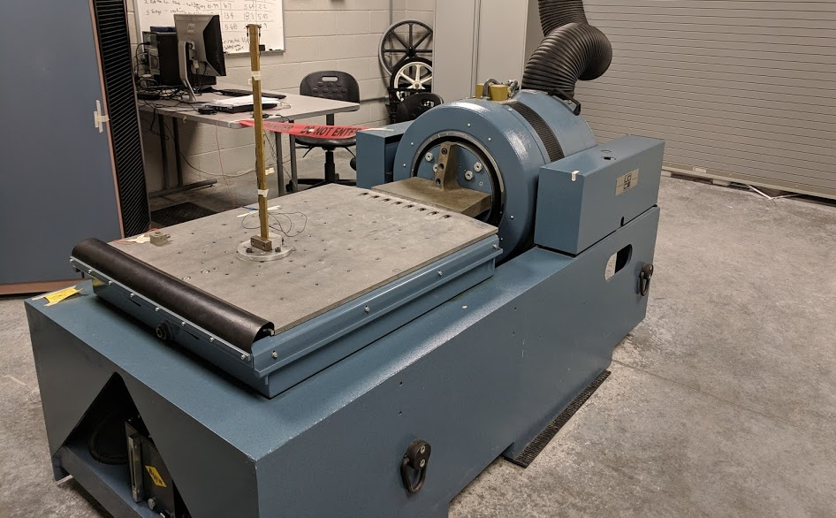
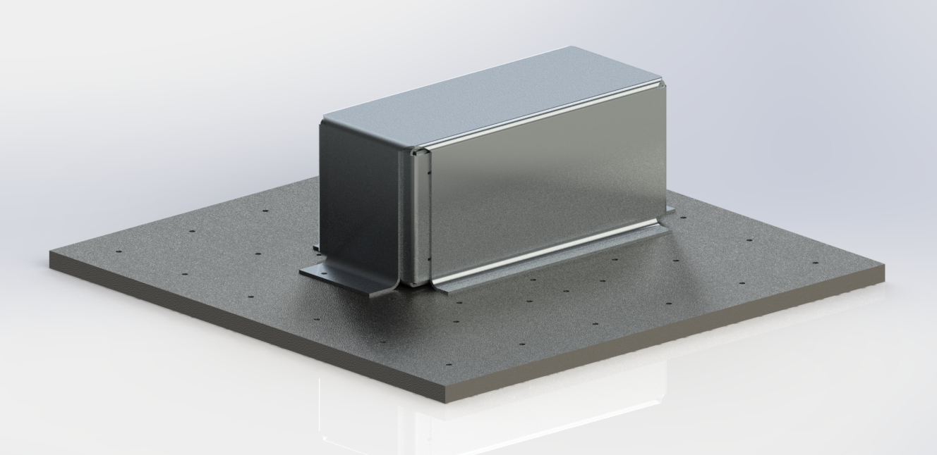
Structural Physical Testing
Physical Testing of the CubeSat will be performed using a Vibration Table
The following tests will be performed
Random Vibration
Harmonic Frequency

Slide 12
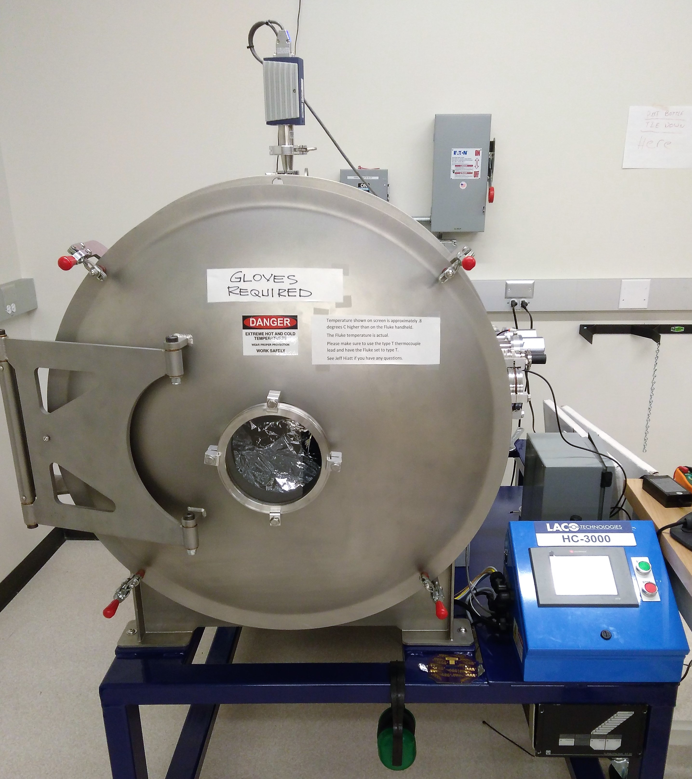
Thermal Physical Testing
We will continue to develop the fidelity of our TD simulation as skills increase
Thermal vacuum bake out tests will be performed with our TVAC chamber

Slide 13
Questions?

